Slide 1


After Engineering What ?
Girish

Slide 2


Road MAP
Basic Education
You are here now
Professional Education
This is next for you
Professional Career
This is the future and you need to plan next step based on this

Slide 3

What can we do after Engineering
Take up a Career with leading MNC as Techie
Move towards Management in due course of time
Aim Towards Management (Think towards MBA and related areas after Engineering)
Higher Studies after Engineering
Master level (within India or Overseas)
Sandwich courses (Master level Ph.D)
Phd (Moving towards a Research Career ..Aiming for a career at …. Eg: IBM Research Labs)
Entrepreneurship - Founding a Startup or Co-founding a startup
Space Research and Development (Public and Private)
Civil Services ( Eg: Indian Engineering Services, IAS, IFS,….)
Join the Indian Armed Forces
Research move towards PhD and Focus on Research and Development of Basic Science
Career as a Faculty at good Engineering Institute or Scientific Institute
Small Scale Industries as Startup (there are too many options)
Govt Service (Right from local corporations … need good engineers)

Slide 4
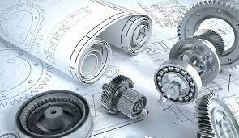
What the areas (….. But not limited)
Design of Electrical Power Plant and grids (Electrical Engineering and Related areas)
High Way Engineering and Modern Transportation (Civil and Architecture)
Design of Water Treatment plans (Water Recycling plants) – (Civil, Environmental , Chemical)
Design of Atmospheric Quality monitoring and analysis (prediction of health) (Chemical, Electronics Software)
Environment Engineering (Design ….Monitoring and compliance)
Tailor Made Software (Computer Science)
Ready to use software (Microsoft, Google and similar products , CAD software….)
Development of Chips - Chip Design Engineers
Board Level Design Engineers – These are the people who design Mother boards
Electronics Verification Engineers
Internet of Thing (IoT)
Aeronautical Engineers (Mechanical)
Food & Beverage processing (Mechanical)
Mining and Geology (Mining Engineering)
Bio Medical Engineering (Instrumentation … electronics)
Bio Tech Engineering (Biology and Math is needed)
Pharma Engineering (Mechanical and Bio Tech)
Surgical Robotics
Mechatronic. Electric Vehicles

Slide 5

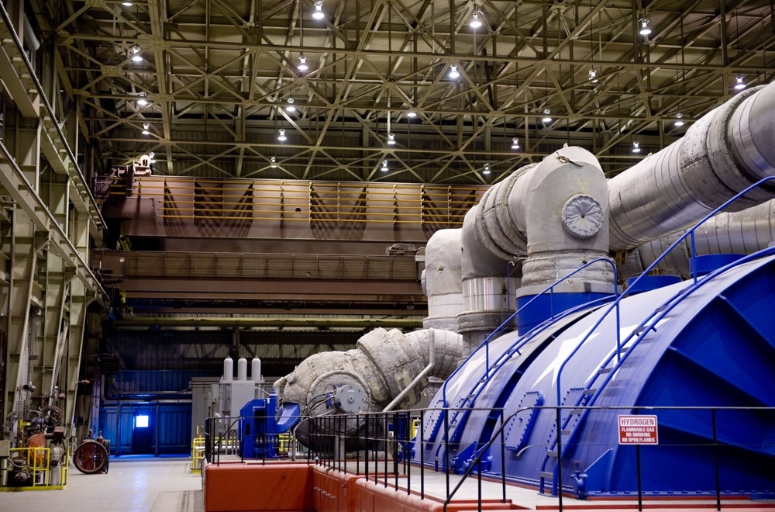
Electrical Power Plant and grids

Slide 6
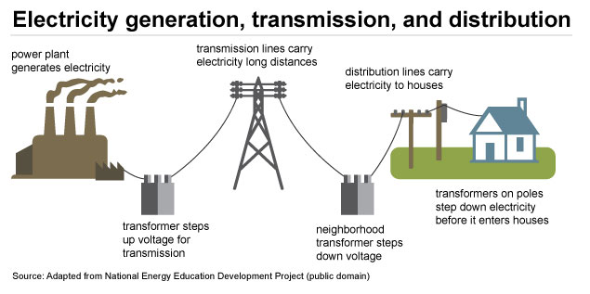

Slide 7
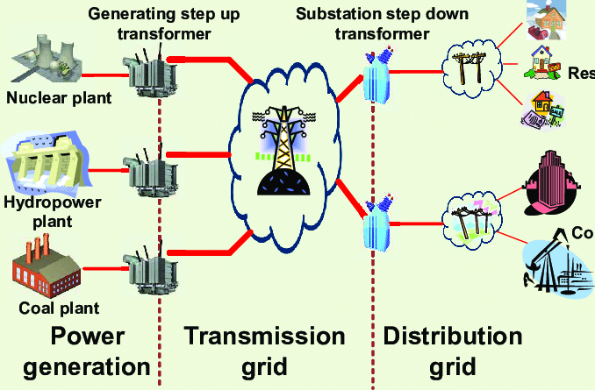

Slide 8
Applied Physics
Applied Mathematics

Slide 9
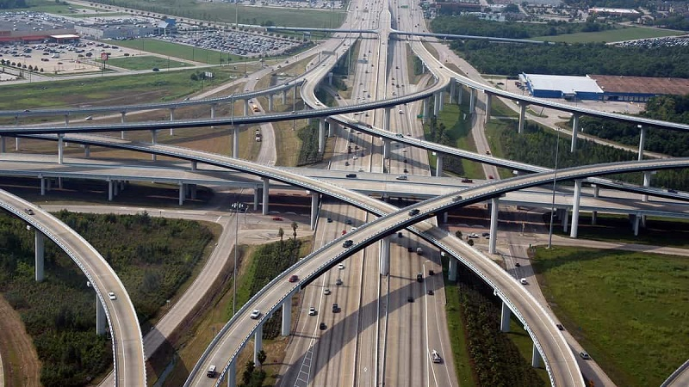


Highway Engineering (Transportation)

Slide 10
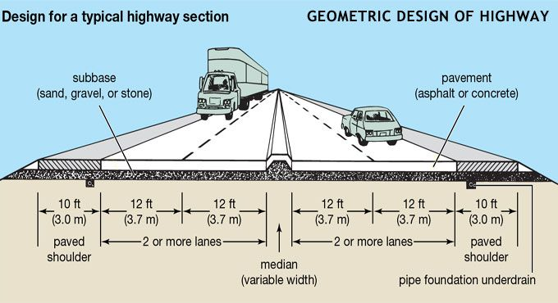

Slide 11

Physics
Applied Mathematics
Branch of Civil Engineering

Slide 12
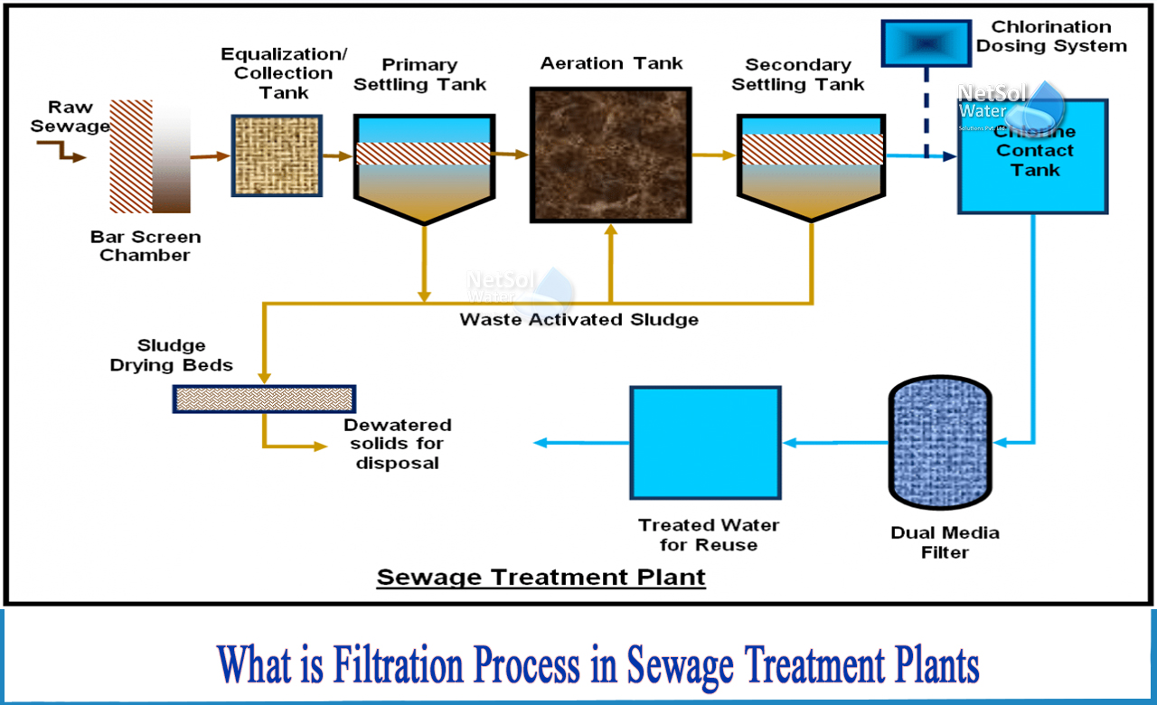
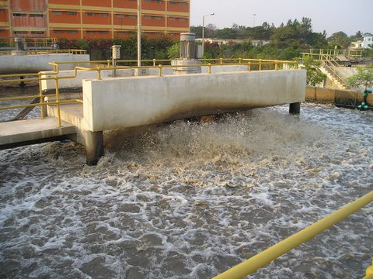
Design of Water Treatment plans (Water Recycling plants) – (Civil, Environmental , Chemical)

Slide 13

Environment Engineering (Design ….Monitoring and compliance)

Slide 14


Slide 15
Physics
Applied Mathematics
Chemistry
Applied Biology
Civil Engineering
Chemical Engineering
Computer Science

Slide 16
Computer Science
Ready to use software (Microsoft, Google and similar products ,
CAD software
Banking
ATM Software
Online Payment
Insurance
Electronic Design Automation
Communication Software ( S/W which control mobile phone towers)
Mobile phone Apps
Animation Software
Video Editing Software development
Games
Machine Learning

Slide 17
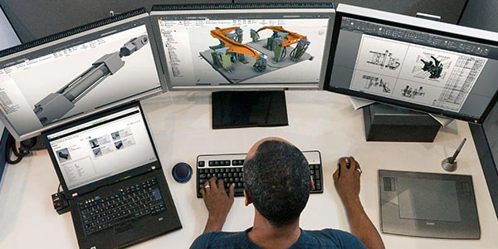

Slide 18
Logical Thinking
Determination to Learn Unlearn Learn… A Curious mind
Basic Mathematics

Slide 19
Electronics Engineering
Development of Chips - Chip Design
Board Level Design – These are the people who design Mother boards
Electronics Verification

Slide 20
Physics
Logic Thinking
Applied Mathematics
Determination to Learn Unlearn Learn… A Curious mind

Slide 21
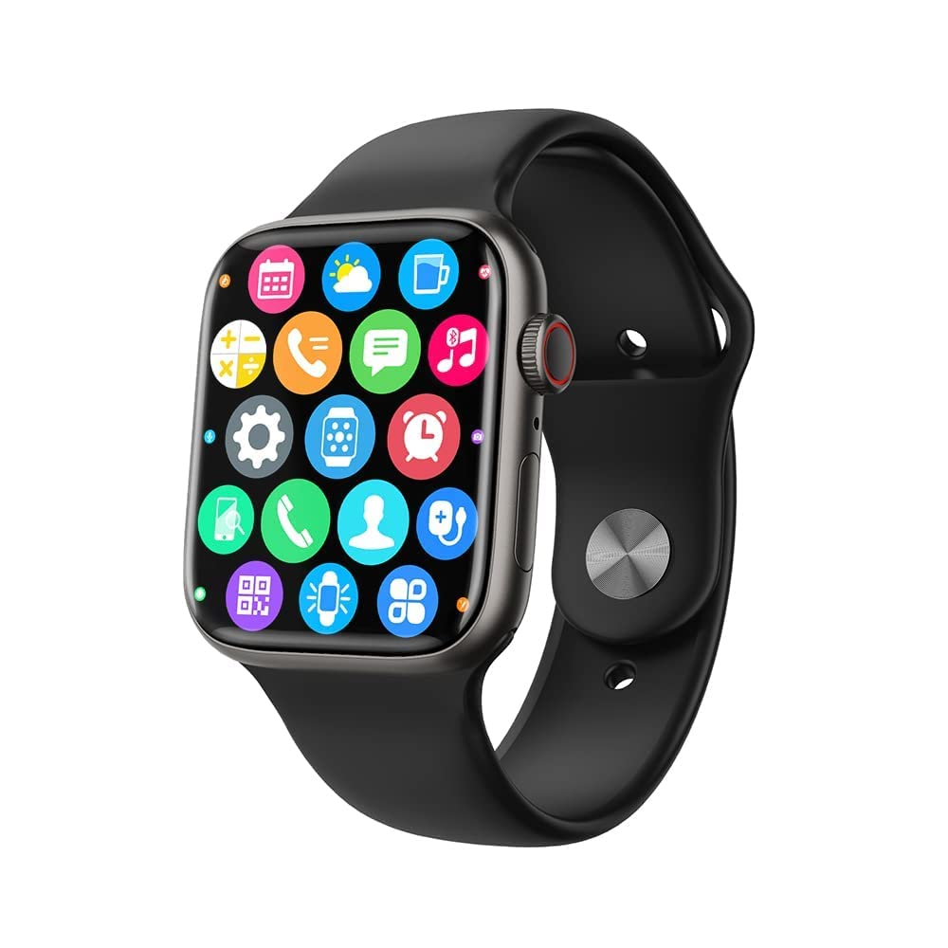
Internet of Things (IoT) & Embedded Computers
The Internet of things (IoT) describes physical objects (or groups of such objects) with sensors, processing ability, software and other technologies that connect and exchange data with other devices and systems over the Internet or other communications networks.
Physics
Electronics
Computer Science

Slide 22
Mechanical Engineering
Logical Thinking
Aeronautical Engineers
Automobile
Textile Machine
Plant and Machines
Food & Beverage processing
Agriculture Machines
Ships and Boats, Submarine
Rockets and Space ships
Visualization
Geometry
Physics
Applied Maths

Slide 23
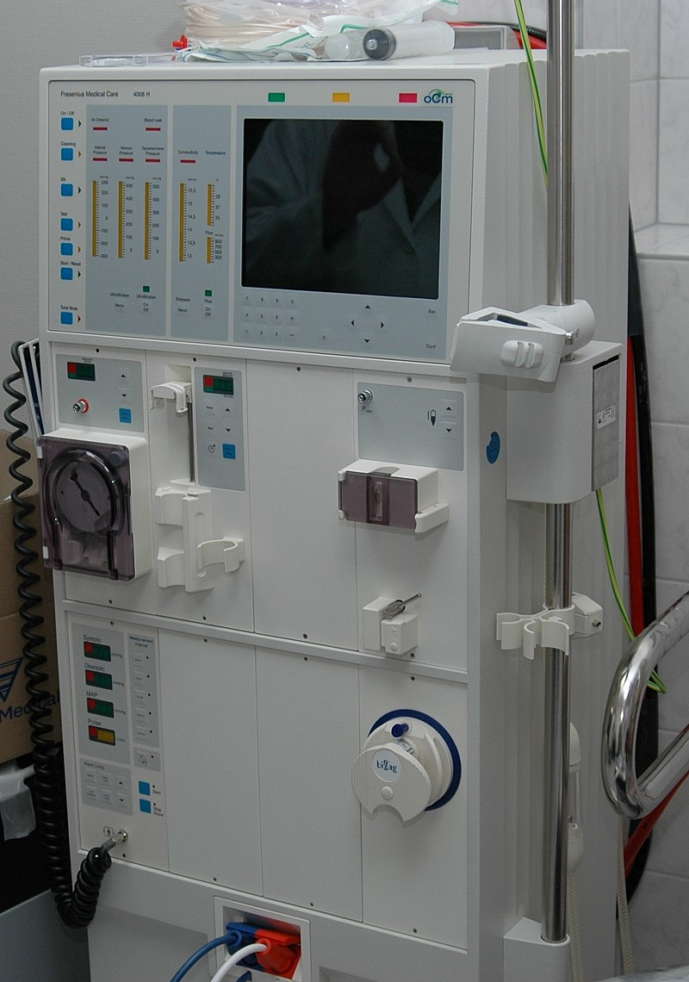
Bio Medical Engineering (Medical Instrumentation )
Bioinformatics
Biomechanics
Biomaterial
Biomedical optics
Genetic engineering
Neural engineering
Hospital and medical devices
Medical imaging
Implants
Biomedical sensors

Slide 24
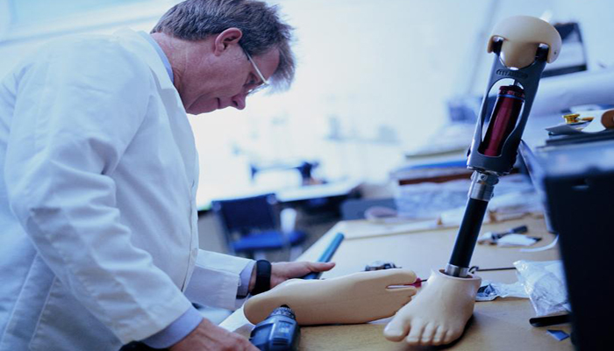

Slide 25
Bio Tech Engineering (Biology and Math is needed)
What is biotechnology engineering, can be described as the fusion of both biology and technology for the research and development of new products. It is an engineering discipline—the field of chemical engineering and applied biology—that includes engineering living organisms. It involves studying micro-organisms, bio-organisms and cell functions in living beings.
Genetics
Virlogy
Ecology
Bio Physics
Bio Statistics

Slide 26
Physics
Applied Mathematics
Chemistry
Applied Biology
Computer Science

Slide 27
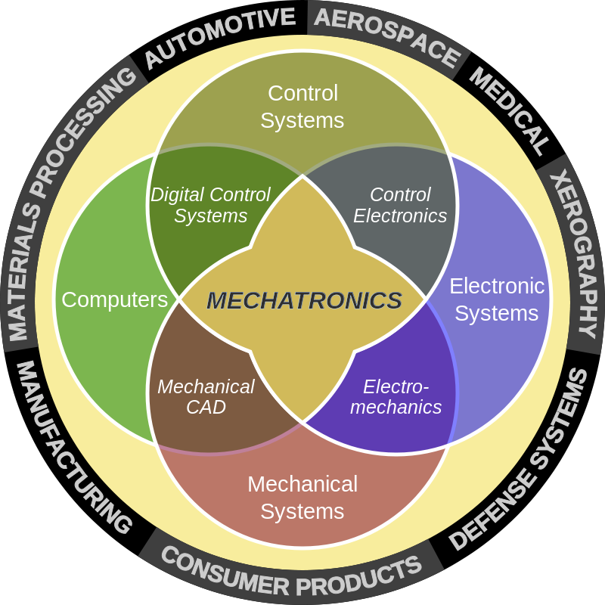
Mechatronics
Mechatronics engineering also called mechatronics, is an interdisciplinary branch of engineering that focuses on the integration of mechanical, electrical and electronic engineering systems, and also includes a combination of robotics, electronics, computer science, telecommunications, systems, control, and product engineering.

